Slide 1

Introduction to Computing & Data Representation
01/13/17

Slide 2
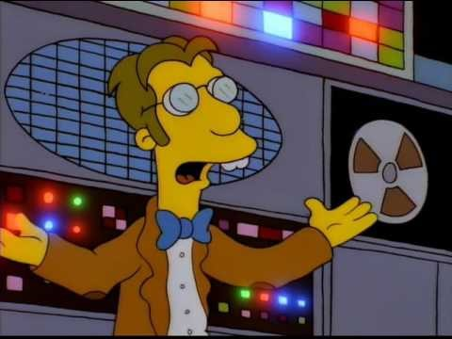
History of Computing
Notes:
https://youtu.be/ykxMqtuM6Ko

Slide 3

History of Computing
"I think there is a world market for maybe five computers." (Thomas Watson, chairman of IBM, 1943)
“Computers in the future may weigh no more than 1.5 tons.” (Popular Mechanics, 1949)
“There is no reason anyone would want a computer in their home.” (Ken Olsen, Digital Equipment Corporation, 1977)
“We will never make a 32-bit operating system.” (Bill Gates, Microsoft, 1989)
“Spam will be a thing of the past in two years’ time.” (Bill Gates, Microsoft, 2004)
Notes:
- Frinkiac 7 https://www.youtube.com/watch?v=ykxMqtuM6Ko

Slide 4
Topics
Computer system overview
Program development
Data representations

Slide 5

Computer Systems

Slide 6
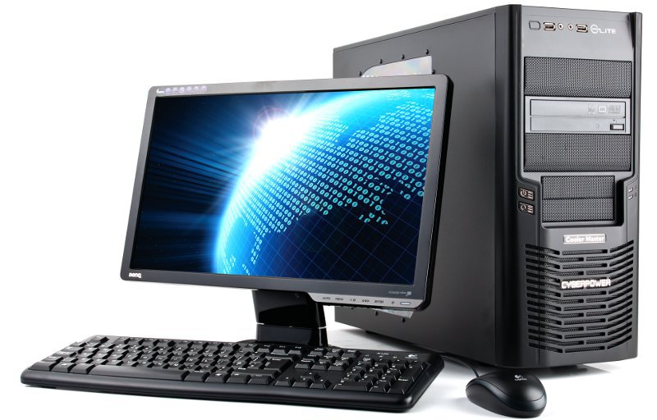
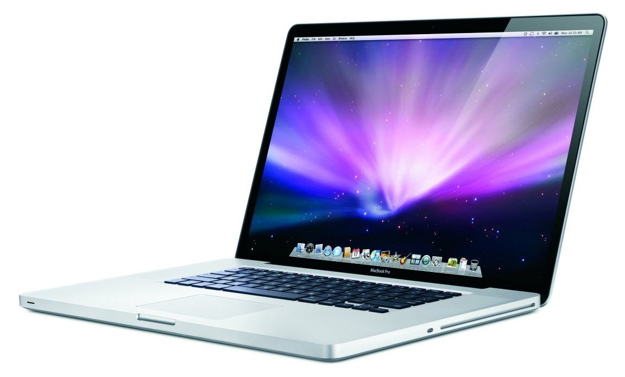
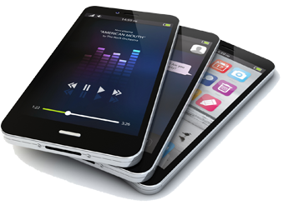
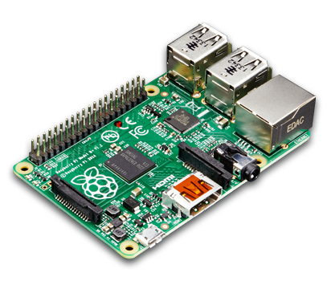
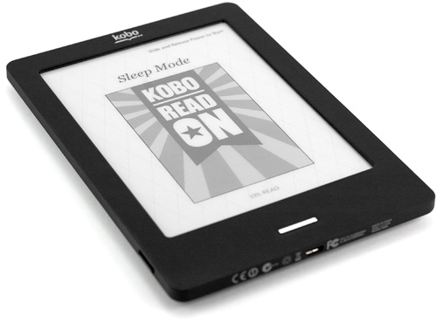
Computer Systems
Notes:
These are all “computers”
For the sake of demonstration, we will consider the common PC

Slide 7
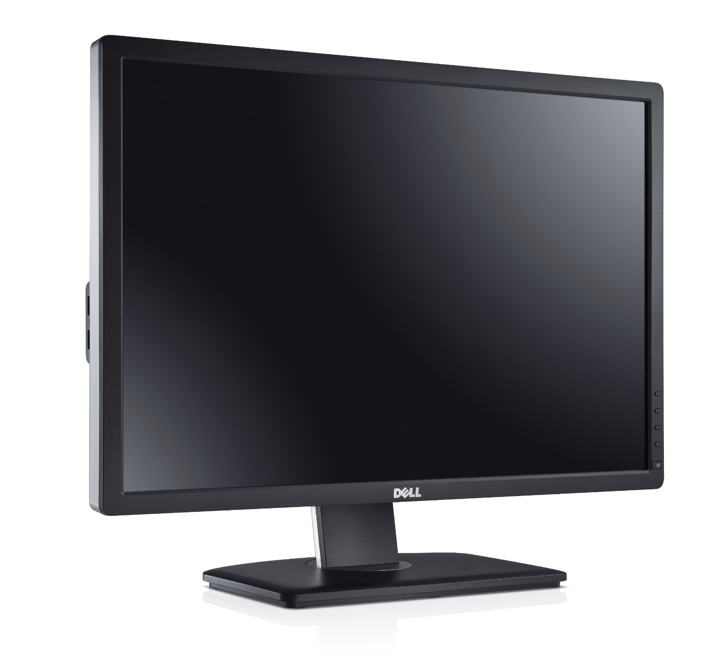
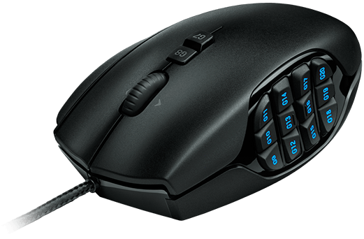
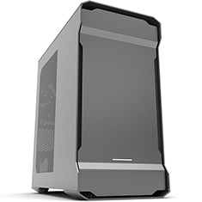

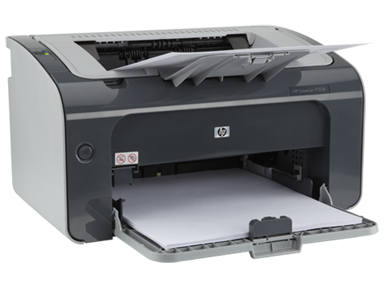
Input
Output

Slide 8
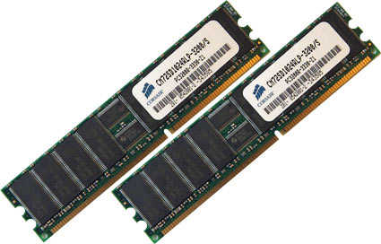
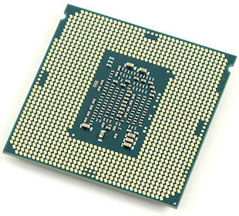
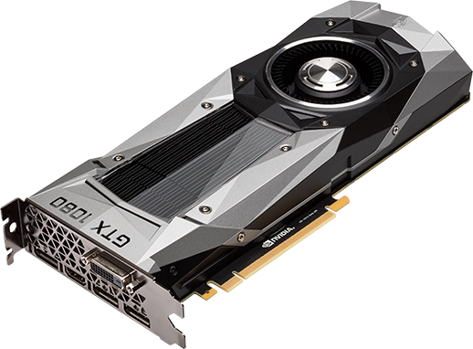
Input
Main Memory (RAM)
CPU
(Central Processing Unit)
GPU (Optional)
Output

Slide 9
Central Processing Unit (CPU)
RAM
Control Unit
Arithmetic Logic Unit (ALU)
Registers
GPU

Slide 10
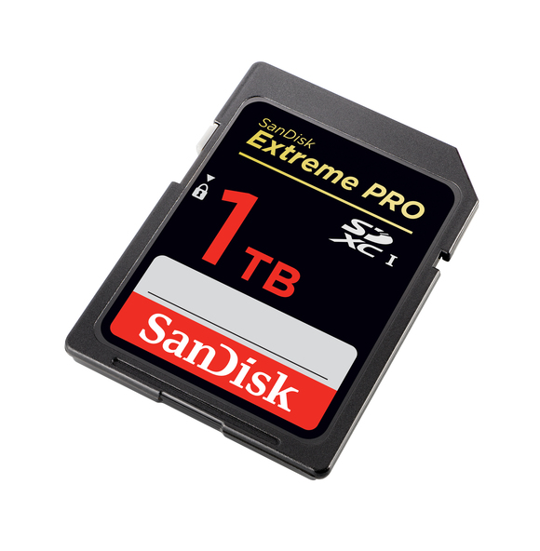
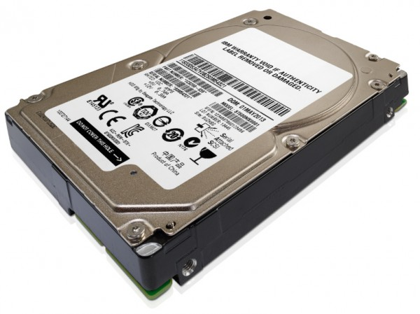
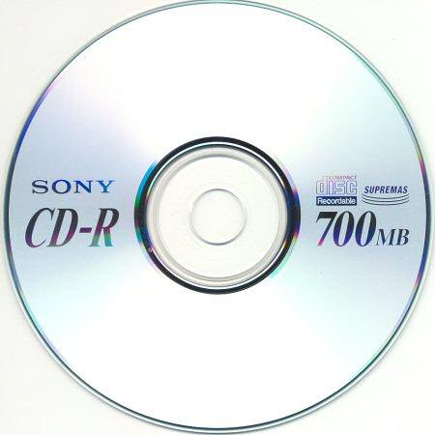
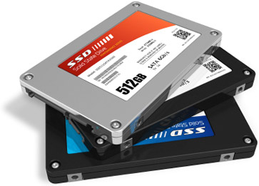
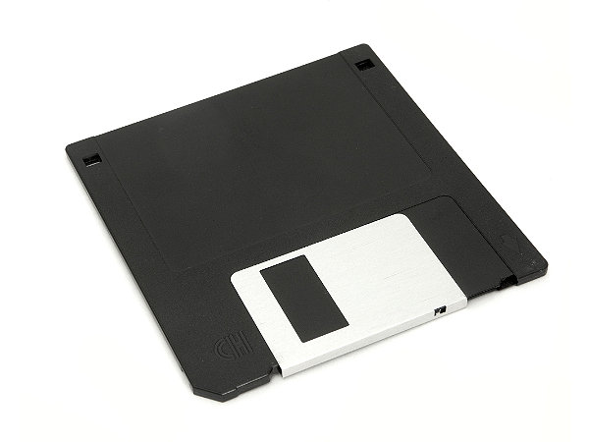
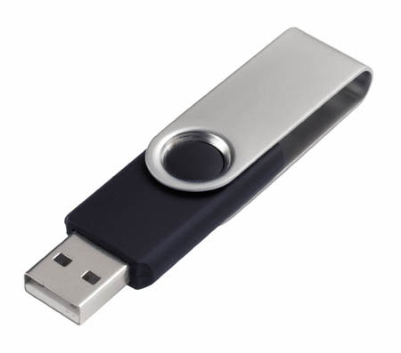
Input
Secondary Storage
RAM
CPU
GPU
Output

Slide 11

Input
Secondary Storage
RAM
Network
CPU
GPU
Output

Slide 12
Notes:
- Computers, at their core, transmit, manipulate, and store data

Slide 13
Data Sources

Slide 14
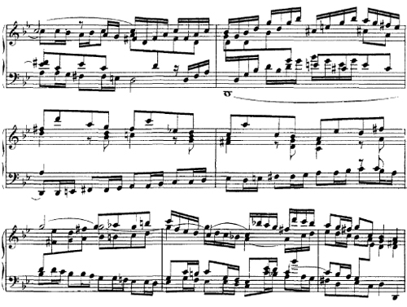
Data Sources

Slide 15
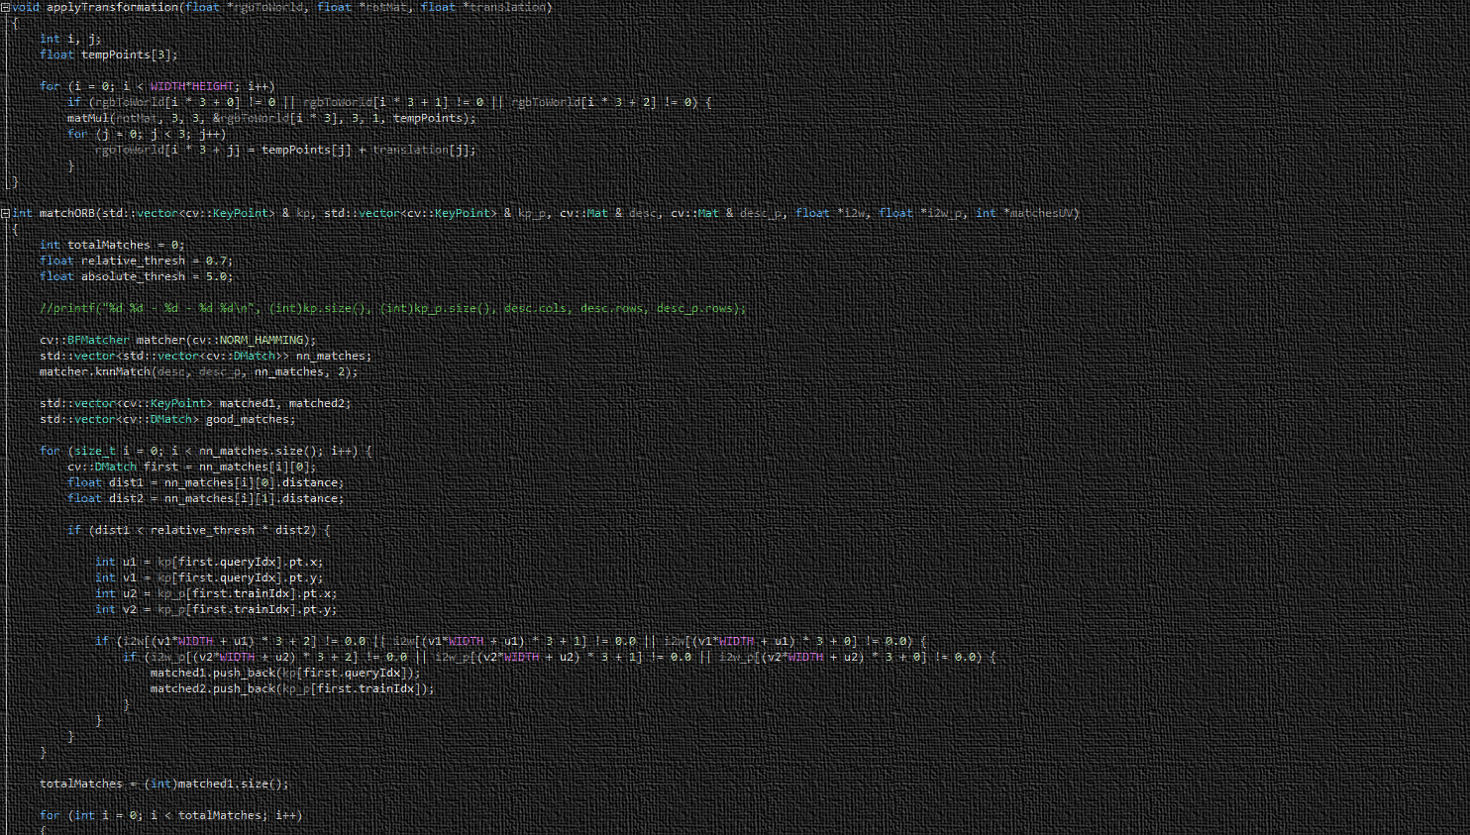
Program Development

Slide 16
Solving Problems
In the general sense:
Define problem
Analyze problem
Design solution
Implement solution
Test and update solution

Slide 17
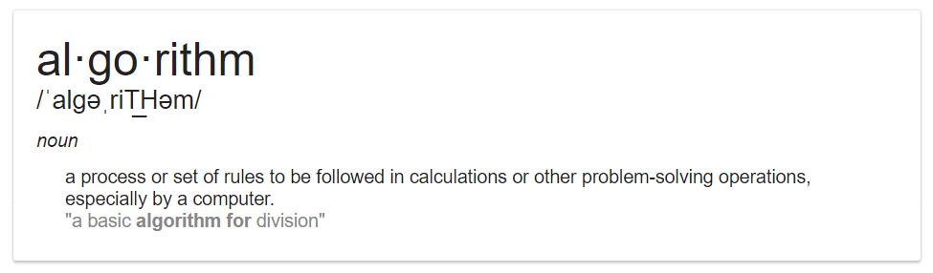
Algorithms
In short, a procedure to solve a problem

Slide 18

Algorithm Characteristics
Steps must be in the correct order
Operations must be unambiguous
Operations must be feasible
A result must be produced …
… in a finite amount of time
Computers do not have critical thinking skills… yet.
Notes:
Computers don’t “make mistakes”, nor do they think for themselves. They do what you tell them to.
Don’t insist your code is correct and accuse the computer of being wrong.

Slide 19
output
input

Slide 20
Input(s)?
Output(s)?

Slide 21
Sorting
Sort the following numbers in ascending order:
6 1 13 7 11 9 2 8
How would you, a human, sort this list?
Do you think a computer could do the same, given your methods?
Notes:
I bet nobody has thought about how to sort a list beyond “sort the list” and then simply doing it.
What, specifically, are the steps?

Slide 22
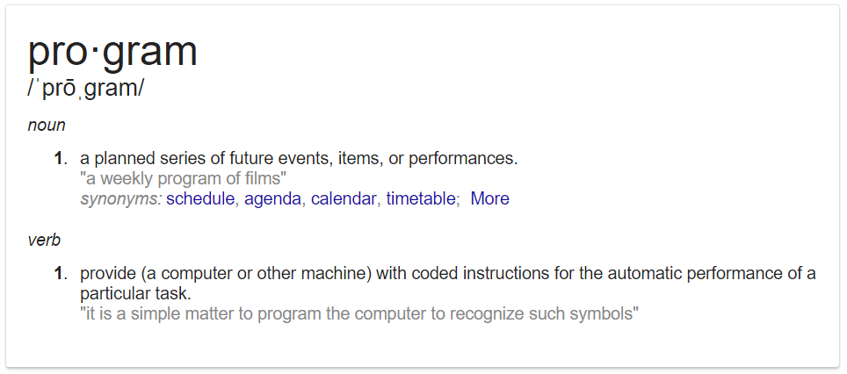
Programs
More simply, a program is a series of instructions that a computer can interpret and execute.
In this course, you will write programs. The more, the better.
Notes:
- A program is the implementation of an algorithm

Slide 23
Programs, Algorithms, & Implementation
Don’t be confused by the jargon
An algorithm can be written in plain English, a program cannot.
Thus, a program is a translation of an algorithm into a language that a computer can understand.
This translation process is called implementation.
A program is an implementation of an algorithm.
Notes:
- Don’t be confused by the jargon

Slide 24

Data Representation

Slide 25
Storage Types
Volatile
Not volatile
Recall:
Secondary Storage
A few registers (8-16), 8MB cache (6700K)
Main memory (RAM): Rarely higher than 64GB. (1GB = 1 billion bytes)
Hard drives, SSDs, multiple Terabyte (1TB = 1 trillion bytes)
How is data represented on these devices?

Slide 26
Binary
Bit (0 or 1)
Byte (group of 8 bits)

Slide 27
Addressing
Every byte has an address.
Bits are not addressed individually.

Slide 28
Understanding Binary Numbers
Decimal: Base 10 number system we’re all used to
Indicates
base
5*10⁵ + 5*10⁴ + 1*10³ + 9*10² + 3*10¹ + 2*10⁰ = 551932
500000 + 50000 + 1000 + 900 + 30 + 2 = 551932
Notes:
- In two slides! (hopefully)

Slide 29
Understanding Binary Numbers
Binary: Base 2 number system
Indicates
base
1*2⁵ + 0*2⁴ + 0*2³ + 1*2² + 0*2¹ + 1*2⁰ = 100101
32 + 0 + 0 + 4 + 0 + 1 = 37

Slide 30
Converting Decimal to Binary
57₁₀
1
1
1
0
0
1
Done!
2⁵ <= 57?
2⁴ <= 25?
2³ <= 9?
2² <= 1?
2¹ <= 1?
2⁰ <= 1?
Yes!
Yes!
Yes!
NO!
NO!
Yes!
Insert 1
57–32 = 25
Insert 1
25–16 = 9
Insert 1
9–8 = 1
Insert 0
Insert 0
Insert 1
1–1 = 0

Slide 31
Hexadecimal
Base 16 (Hex = 6, Decimal = 10)
Decimal goes from 0-9, Hexadecimal goes from 0 to F.
Decimal
Hex

Slide 32
Binary to and from Hex
Divide the binary number into sets of 4 bits
Convert each set of bits into a hex digit
or 0x10F9

Slide 33
Octal
Base 8 (oct = 8, octagon), digits go from 0-7
Conversion follows same procedure as Hex, with one difference:
Divide binary number into groups of 3 bits instead of 4 bits.
1010000111101100₂
Note leading zeroes!
001 010 000 111 101 100
1 2 0 7 5 4
120754₈

Slide 34
Data Types
We’ve seen:
Number systems (decimal, binary, hex, octal)
unsigned integer (positive, whole numbers)
Next we will look at:
Signed integer (whole number, can be positive or negative)
Floating point (real numbers, positive or negative)
Characters (‘A’, ‘b’, ‘=‘, ‘#’, any single character)

Slide 35
Integers
In practice, integers are 16, 32, or 64 bits.
In this course, you will deal almost exclusively with 32 bit integers
Recall:
Only 6 bits here
How to convert to 32?
Add leading zeroes: 00000000000000000000000000100101
In base 10, 578 is the same number as 000000578. Same applies in binary.

Slide 36
Signed Integer
Two options:
Sign-and-Magnitude
Two’s Complement
Sign and magnitude: Use the left-most bit as a sign bit
Sign bit:
0 = positive
1 = negative

Slide 37
Two’s Complement
Write the positive number in binary. If the number is positive, stop here.
If the number is negative, Invert the bits (1s becomes 0s, 0s become 1s)
Add 1 (add 1 to the VALUE of the number, do NOT append 1)

Slide 38
Two’s Complement
To convert a two’s complement binary number back to decimal, simply perform the process again in the same order:
1 1 1 1 0 1 1 1
Negative!
first bit is 1
Invert: 0 0 0 0 1 0 0 0
Add 1: 0 0 0 0 0 0 0 1
0 0 0 0 1 0 0 1
At this point, convert to decimal using previously described method.
But remember! The final number is negative because the first bit was 1.

Slide 39
Real (Floating Point) Numbers
Decimal (Base 10)
123.4 = 1.234 x 10²
Binary (Base 2)
?

Slide 40
IEEE-754
Most widely used standard for floating point computation
32-bit – Single Precision:
0 1 0 0 0 0 0 1 0 0 0 1 0 0 0 0 0 0 0 0 0 0 0 0 0 0 0 0 0 0 0 0
sign bit
Exponent (8 bits)
Mantissa (23 bits)
64-bit – Double Precision:
0 1 0 0 0 0 0 1 0 0 0 1 0 0 0 0 0 0 0 0 0 0 0 0 0 0 0 0 0 0 0 0 0 0 0 0 0 0 …
sign bit
Exponent (11 bits)
Mantissa (52 bits)

Slide 41
Convert Decimal to IEEE-754
Example: Convert 3.875₁₀ to IEEE-754

Slide 42
Convert Decimal to IEEE-754
Step 1: Convert absolute value to binary
Example Decimal Number: 5.875₁₀
3₁₀ = 101 ₂
0.875 x 2 = 1.75
0.75 x 2 = 1.5
0.5 x 2 = 1.0
0.0 x 2 = 0.0
0.875₁₀ = 0.111 ₂

Slide 43
Convert Decimal to IEEE-754
Step 1: Convert absolute value to binary
Example Decimal Number: 5.875₁₀
5
.875
8 4 2 1
¹/₂ ¹/₄ ¹/₈

Slide 44
Convert Decimal to IEEE-754
Step 2: Append exponent indicator
101.111 x 2⁰
Step 3: Normalize (increment exponent)
Decimal moves left, exponent goes up (scientific notation)
1.01111 x 2²
Mantissa

Slide 45
Convert Decimal to IEEE-754
Step 4: Add bias to exponent
Bias is 127 for 32-bit, 1023 for 64-bit
From 3) 3.875 = 1.01111 x 2² -> exponent is 2 + 127 = 129
Step 5: Convert exponent to binary
129₁₀ = 1 0 0 0 0 0 0 1₂

Slide 46
Convert Decimal to IEEE-754
Step 6: Set sign bit, place mantissa and exponent
5.875₁₀
From Step 5:
From Step 3:
1.01111 x 2²
129₁₀ =
0
1 0 0 0 0 0 0 1
0 1 1 1 1 0 0 0 0 0 0 0 0 0 0 0 0 0 0 0 0 0 0
sign bit
Exponent (8 bits)
Mantissa (23 bits)

Slide 47
More IEEE-754
Convert 18.75₁₀ to 32-bit floating point format.
Notice the right side of the decimal! Recall:
1) 18.75₁₀ = 10010.11₂
¹/₂ ¹/₄ ¹/₈
2-4) Exponent: 10010.11₂ x 2⁰ = 1.001011₂ x 2⁴, 4 + 127 = 131
5) 131₁₀ = 1000 0011₂
6) Place components
0 1 0 0 0 0 0 1 1 0 0 1 0 1 1 0 0 0 0 0 0 0 0 0 0 0 0 0 0 0 0 0
sign bit
Exponent (8 bits)
Mantissa (23 bits)

Slide 48
Even More IEEE-754

Slide 49
Characters
Expressed using the ASCII table

Slide 50
ASCII Table

Slide 51
Characters are 1 byte (8 bits) each
Notice: The character ‘1’ does not have the ASCII value of 1. Rather, its value is 49. The difference between the integer 1 and the character ‘1’ is VERY important!

Slide 52
Questions?

